Slide 1
NAÏVE BAYES
T.K.Senthil Kumar

Slide 2
BAYES THEOREM
Bayes theorem describes the probability of an event, based on prior knowledge of conditions that might be related to the event

Slide 3
Naïve Bayes
The Naive Bayesian classifier is based on Bayes’ theorem with the independence assumptions between predictors.
A Naive Bayesian model is easy to build, with no complicated iterative parameter estimation which makes it particularly useful for very large datasets.
Despite its simplicity, the Naive Bayesian classifier often does surprisingly well and is widely used because it often outperforms more sophisticated classification methods.
Bayes theorem provides a way of calculating the posterior probability, P(c|x), from P(c), P(x), and P(x|c).
Naive Bayes classifier assume that the effect of the value of a predictor (x) on a given class (c) is independent of the values of other predictors. This assumption is called class conditional independence.

Slide 4
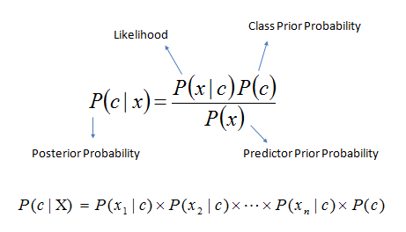
Naïve Bayes
P(c|x) is the posterior probability of class (target) given predictor (attribute).
P(c) is the prior probability of class.
P(x|c) is the likelihood which is the probability of predictor given class.
P(x) is the prior probability of predictor.

Slide 5
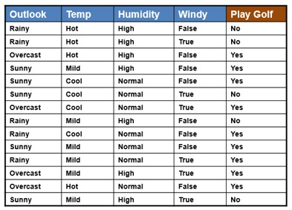
Example

Slide 6
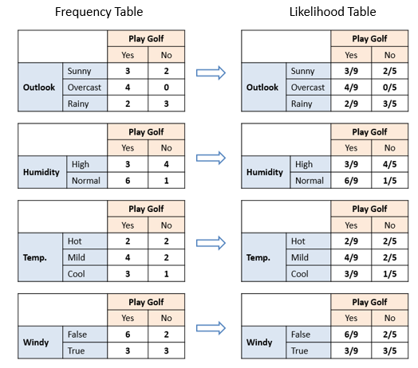

Slide 7
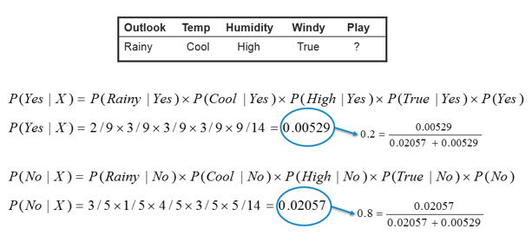

Slide 8
Zero-Frequency Problem
Add 1 to the count for every attribute value-class combination (Laplace estimator) when an attribute value (Outlook=Overcast) doesn’t occur with every class value (Play Golf=no)

Slide 9
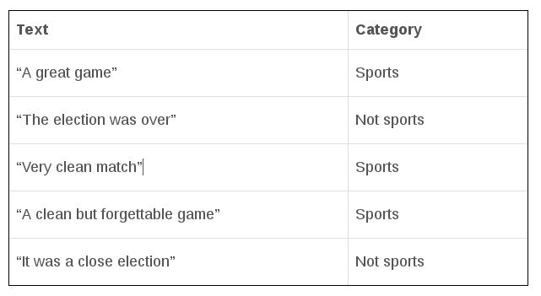
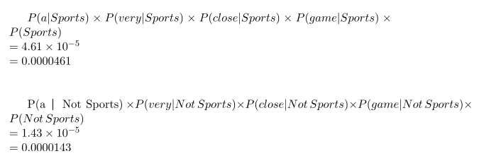

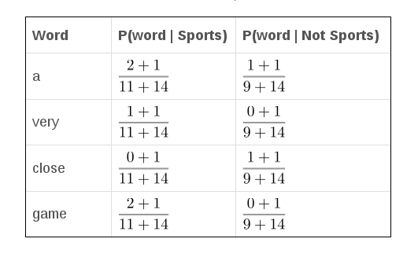
P(a very close game | Sports) = ?

Slide 10
Python Packages
Bernouli Naïve Bayes
Multinomial Naïve Bayes
Gaussian Naïve Bayes

